Slide 1
U.S Perm Visa Case status Classification
Group members:
Ajitesh Chauhan
Rishi Dave
Shefali Kolge

Slide 2
Introduction
A permanent labor certification issued by the Department of Labor (DOL) allows an employer to hire a foreign worker to work permanently in the United States.
In most instances, before the U.S. employer can submit an immigration petition to the Department of Homeland Security's U.S. Citizenship and Immigration Services (USCIS), the employer must obtain a certified labor certification application from the DOL's Employment and Training Administration (ETA).
The DOL must certify to the USCIS that there are not sufficient U.S. workers able, willing, qualified and available to accept the job opportunity in the area of intended employment and that employment of the foreign worker will not adversely affect the wages and working conditions of similarly employed U.S. workers

Slide 3
Objective
Any organization formed in US can request the Consulate for the permanent visa of an employee.
Based on various norms that the government implies the organization needs to file the application accordingly.
There are 3 Steps post which the person gets the permanent residency in USA. PERM filing being the most important and crucial step in this process.
We are going to predict, based on the PERM form data , the case status of the application.

Slide 4
Design
Data Understanding
Data Preparation
Model Building
Evaluation
Insights

Slide 5
Data Understanding
It contains administrative data from employer’s Applications for Permanent Employment Certification and certification determinations processed by the Department’s Office of Foreign Labor Certification, Employment and Training Administration.
https://www.foreignlaborcert.doleta.gov/docs/Performance_Data/Disclosure/FY16Q2/PERM_FY16_Record_Layout.pdf
Above is the link for data information pdf.

Slide 6
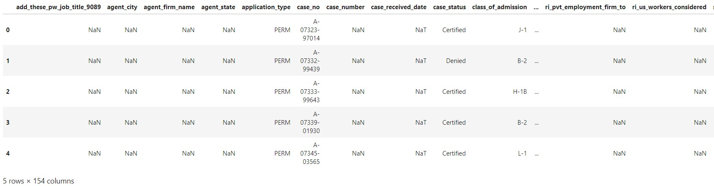
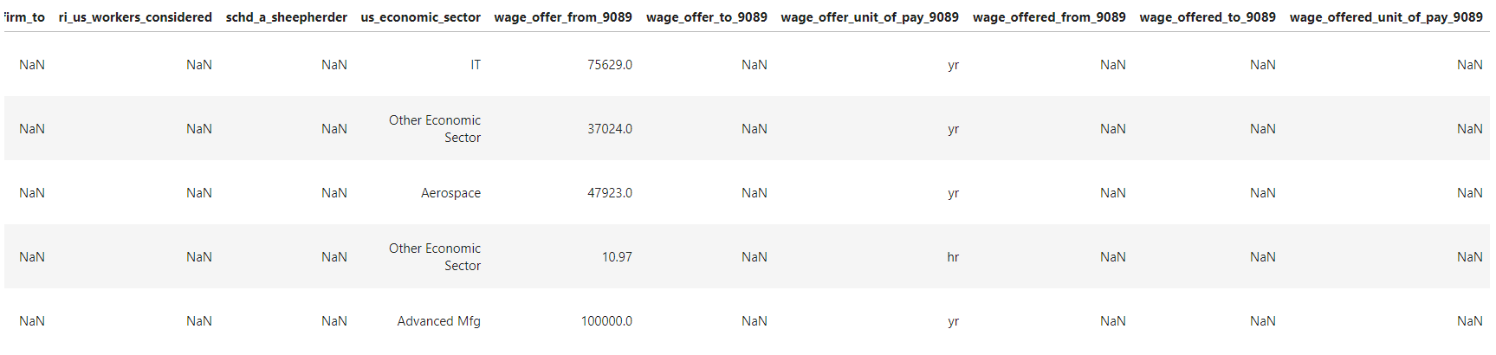
Sample Data

Slide 7
Data Preparation
Prepared target variable: Certified and Denied status.
Merged attributes that had same meaningful data. Basically, checked for overlapping values, then filled NA.
Calculated Prevailing wage yearly and performed binning. (Some values were hourly, some monthly, etc)
Edited attribute with job titles, removed the level of each title and made it a general title. Example: Computer Systems Analyst – II, Computer Systems Analyst - V to Computer Systems Analyst
Leaving columns which have more than 250000 non-missing observations

Slide 8
Workflow
Prepared target variable: Certified and Denied status.
Data cleaning
Leaving columns which have more than 250000 non-missing observations
Checking and imputing NA values
Feature Selection and Engineering
Data type conversion
Applying Tree-based model
Random Forest
Decision Tree
Gradient Boosting Classifier
Applying over sampling and under sampling techniques (SMOTE and NearMiss respectively)

Slide 9
Exploratory Data Analysis

Slide 10
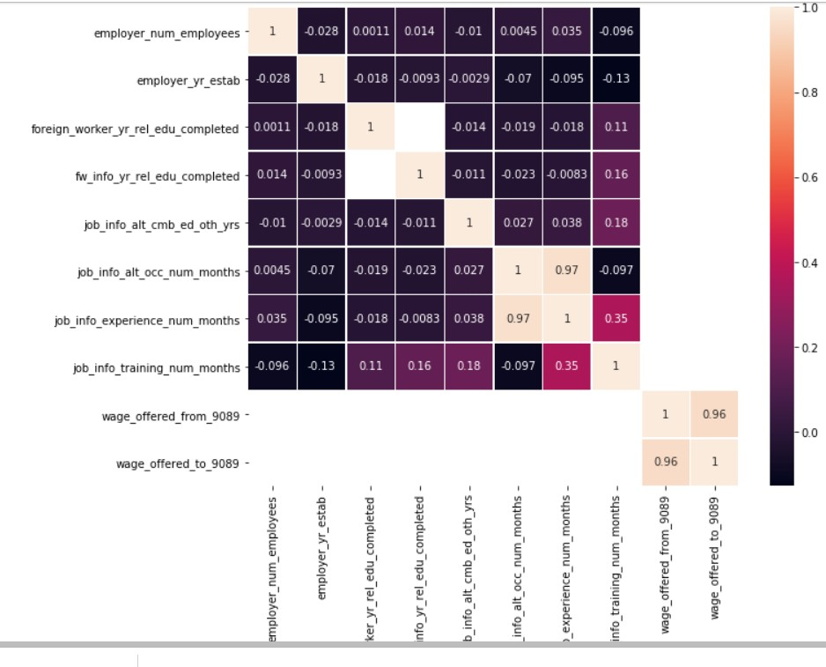
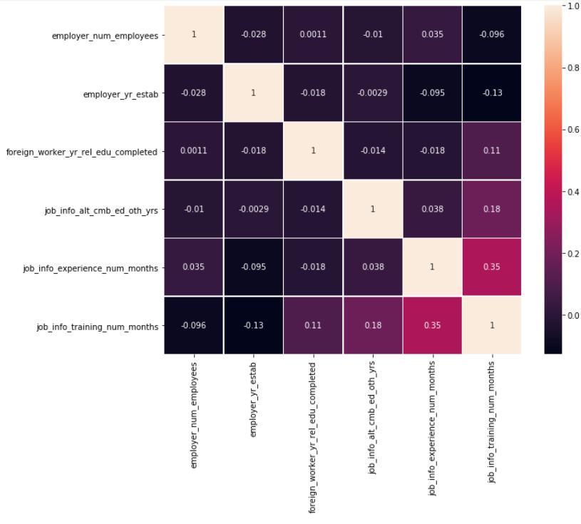
Correlation

Slide 11
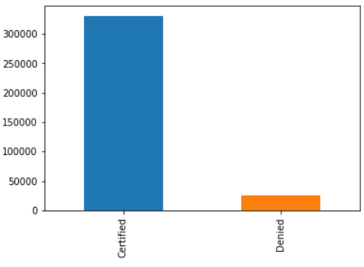
Target variable

Slide 12
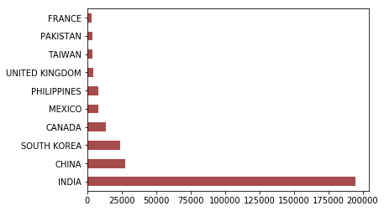
Inference: India has the highest number of applications followed by China

Slide 13
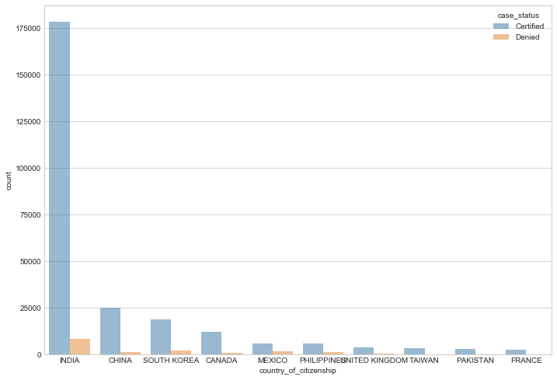
Inference:
Also the Number of certified cases are from India and has a very low cases of denied as compared to the number of applications and also the certified cases

Slide 14
Techniques used and its metrics
 | Test Acc | Train Acc | Test Recall | Train Recall
Random Forest | 0.95 | 0.99 | 0.33 | 0.99
RF with SMOTE | 0.93 | 0.99 | 0.45 | 0.99
RF with NearMiss | 0.35 | 0.37 | 0.89 | 1.0
Decision Tree | 0.92 | 1.0 | 0.49 | 1.0
Decision Tree with SMOTE | 0.88 | 1.0 | 0.49 | 1.0
Decision Tree with NearMiss | 0.47 | 0.49 | 0.78 | 1.0
Gradient Boosting (learning_rate = 1.0) | 0.94 | 0.93 | 0.14 | 0.14
Gradient Boosting with SMOTE | 0.83 | 0.83 | 0.51 | 0.51
Gradient Boosting with NearMiss | 0.50 | 0.49 | 0.73 | 0.73

Slide 15
Thank You

